Slide 1




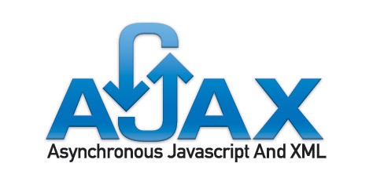
ASP.NET AJAX – Basics
ASP.NET Web Forms
Telerik Software Academy
http://academy.telerik.com

Slide 2


Table of Contents
What is AJAX?
AJAX Concept
ASP.NET AJAX Framework
ASP.NET AJAX Server Controls
ScriptManager, UpdatePanel
Timer, Update Progress
Triggers
ASP.NET AJAX Control Toolkit

Slide 3
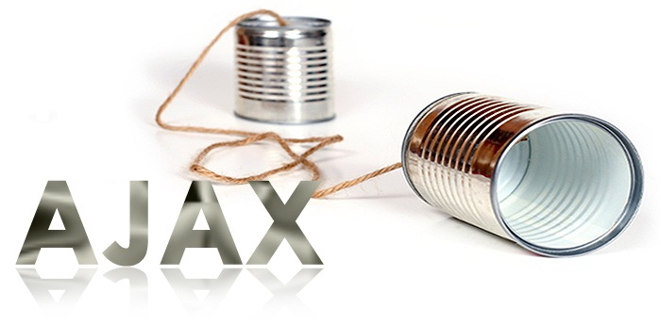
What is AJAX?

Slide 4
What is AJAX?
AJAX = Asynchronous JavaScript And XML
Allows updating parts of a Web page at runtime
Approach for developing dynamic Web sites
Not a particular technology
There are over 50 AJAX frameworks
http://en.wikipedia.org/wiki/List_of_Ajax_frameworks
ASP.NET AJAX is Microsoft’s AJAX framework
Part of ASP.NET and .NET Framework
Supported by Visual Studio

Slide 5
What is AJAX? (2)
AJAX enables you to pass information between a Web browser and Web server without refreshing the entire Web page
Done by asynchronous JavaScript HTTP requests and dynamic page updates
HTTP
Data
(HTML /
JSON /
XML / …)
HTTP
Client Web Browser
Server

Slide 6
AJAX Technology Components
DHTML + DOM
Browser DOM manipulated through JavaScript
Used to dynamically display and interact with the page contents
CSS stylesheets for formatting
XMLHttpRequest object
Exchange data asynchronously with the Web server through asynchronous HTTP requests
Any data format could be used: HTML fragments, text fragments, XML, JSON, etc.
6
Notes:
6
10/21/2014 11:01 AM
©2005 Microsoft Corporation. All rights reserved.
This presentation is for informational purposes only. Microsoft makes no warranties, express or implied, in this summary.
6

Slide 7
AJAX Styles
Two different styles of AJAX:
Partial page rendering
Loading of HTML fragment and showing it inside a <div>
Implemented with UpdatePanel in ASP.NET
JSON service
Loading JSON object from the server and client-side processing it with JavaScript / jQuery
Implemented as WCF + jQuery AJAX

Slide 8


ASP.NET AJAX Framework

Slide 9
What is ASP.NET AJAX?
ASP.NET AJAX is AJAX development framework from Microsoft
Standard part of .NET Framework
Allows quickly creating highly interactive Web applications, easy-to-use, highly productive
Supports both popular approaches:
Server-centric (partial page rendering)
Client-centric (client-side control rendering)
Works on all modern browsers: Internet Explorer, Firefox, Safari, Chrome, Opera
9
Notes:
9

Slide 10
ASP.NET AJAX Architecture
XHTML, CSS,
JavaScript,
AJAX
Markup
AJAX-enabled
ASP.NET Pages
Web Services
(ASMX or WCF)
AJAX Client Script Library
ASP.NET AJAX Server Extensions
Controls, Components
App Services Bridge
AJAX
Server Controls
Component Model and UI Framework
Asynchronous Communication
Base Class Library
Script Core Library
ASP.NET 4.0
Page Framework,
Server Controls
Application Services
Browser Compatibility
Client Framework and Services
Server Framework
10
Notes:
10
10/21/2014 11:01 AM
©2005 Microsoft Corporation. All rights reserved.
This presentation is for informational purposes only. Microsoft makes no warranties, express or implied, in this summary.
10

Slide 11
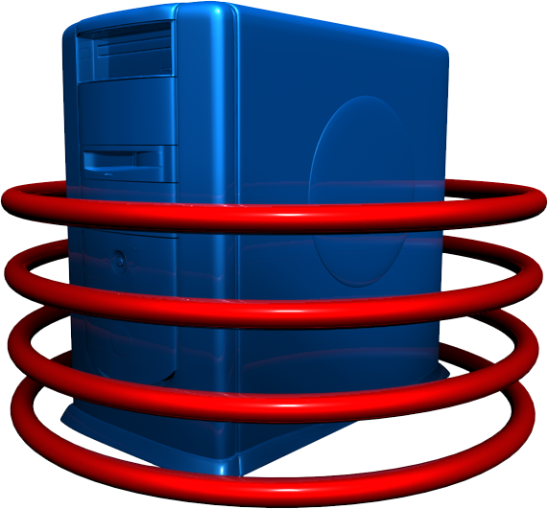

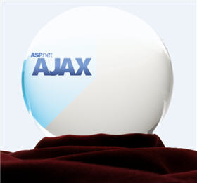
ASP.NET AJAX Server Controls

Slide 12
ASP.NET AJAX Server Controls
ASP.NET AJAX server controls allow easily build rich experiences with ASP.NET
Application UI and core logic still run on server
Avoid need to master the JavaScript and asynchronous programming
Use AJAX techniques to reduce full round trips
Enable incremental page UI updates
Examples: data navigation and editing, form validation, auto refresh, auto-complete, etc.

Slide 13
ScriptManager Control
<asp:ScriptManager> control
Manages:
AJAX components
Partial page rendering
Client requests and server responses on ASP.NET server pages.
Only one manager control per .aspx page
Automates the JavaScript callbacks
Required once in the page to enable AJAX

Slide 14
UpdatePanel Control
<asp:UpdatePanel> control
Easily define "updatable" regions of a page
Implements the server-side AJAX approach (partial page rendering)
Server roundtrips become asynchronous
<asp:UpdatePanel id="UpdatePanelDemo" runat="server">
<ContentTemplate>
<!-- This content can be dynamically updated !->
<asp:Calendar id="CalendarDemo" runat= "server" />
<ContentTemplate>
</asp:UpdatePanel>

Slide 15


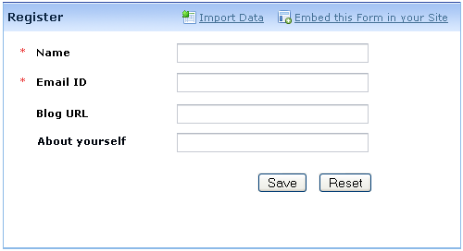

Dynamic Forms with ASP.NET AJAX
Live Demo

Slide 16
UpdatePanel.UpdateMode
UpdatePanel.UpdateMode property:
UpdateMode = Always (default)
Updates the panel for all postbacks that originate from the page (synchronous and asynchronous)
UpdateMode = Conditional
Updates the panel when something inside it is changed (by default ChildrenAsTrigger=True)
Or by calling Update() method explicitly
Or by triggers defined in the update panel

Slide 17
Triggers
Triggers cause update of the UpdatePanel’s content on particular event
Can be controls inside or outside the panel
<asp:UpdatePanel ID="UpdatePanelWithTriggers"
runat="server" UpdateMode="Conditional">
<Triggers>
<asp:AsyncPostBackTrigger
ControlID="TimerDemo" EventName="Tick" />
</Triggers>
<ContentTemplate>
</ContentTemplate>
</asp:UpdatePanel>

Slide 18
Triggers (2)
AsyncPostBackTrigger
Converts postbacks into async callbacks
Typically used to trigger updates when controls outside an UpdatePanel post back
If ChildrenAsTriggers="false", can be used to specify which controls inside UpdatePanel should call back rather than post back
PostBackTrigger
Lets controls inside UpdatePanel post back.
Typically used to allow certain controls to post back when ChildrenAsTriggers="true"

Slide 19
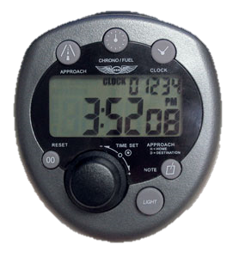
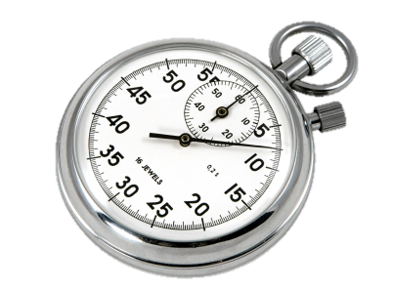
Timer Control
<asp:Timer> control
Added as a trigger of an update panel
Refreshes panel when timer interval expires
<asp:Timer ID="TimerDemo" runat="server" Interval="5000">
</asp:Timer>

Slide 20
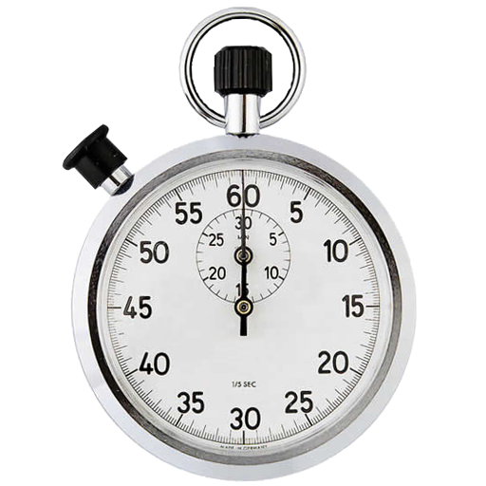

ASP.NET AJAX: UpdatePanel + Timer
Live Demo

Slide 21
UpdateProgress Control
<asp:UpdateProgress> control
Shows status while an asynchronous postback is in progress
Button to cancel the request can be added
<asp:UpdateProgress ID="UpdateProgressDemo"
runat="server">
<ProgressTemplate>
Updating ...
</ProgressTemplate>
</asp:UpdateProgress>

Slide 22
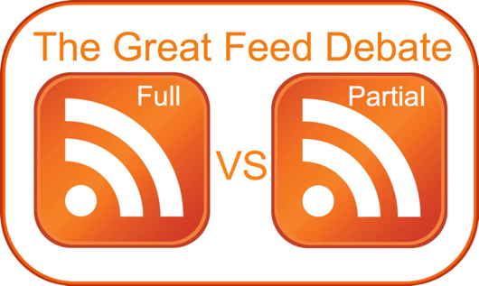

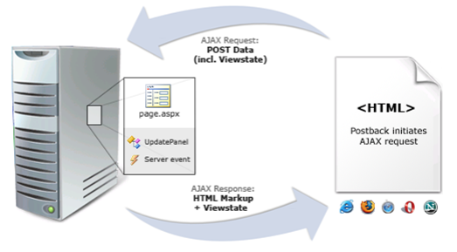


Full vs. Partial Postbacks
Live Demo

Slide 23




ASP.NET AJAX Control Toolkit

Slide 24
ASP.NET AJAX Control Toolkit
Collection of AJAX components
Ready-to-go samples
Comes with full source code and documentation
SDK to simplify the creation and re-use custom AJAX-enabled ASP.NET controls
Some controls:
CascadingDropDown – link drop-downs, with asynchronous population and no postbacks
CollaspiblePanel – panels that collapse and expand without postbacks
24

Slide 25
ASP.NET AJAX Control Toolkit (2)
ConfirmButton: extender adding a confirm dialog to any Button, LinkButton, or ImageButton control
DragPanel: makes any panel into an object that you can drag around the page
ModalPopup: shows a modal popup dialog
... and many more ...
Home Page:
http://asp.net/ajax/ajaxcontroltoolkit/
25

Slide 26
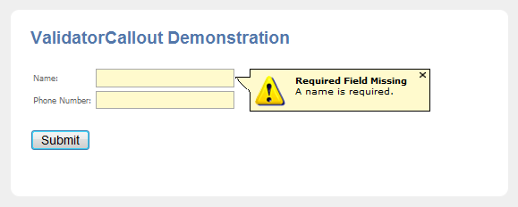
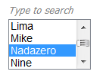
AJAX Control Toolkit
Live Demo

Slide 27


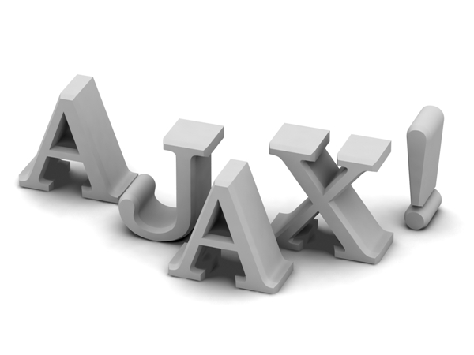
ASP.NET AJAX Basics
Questions?

Slide 28
Exercises
Create an AJAX-enabled Web site which shows Employees and their Orders in two GridView controls (use the Northwind database and Entity Framework). Put the GridView for the orders inside an update panel. Add UpdateProgress which shows an image while loading (simulate slow loading with Thread.Sleep()).
When the user selects a row in employees GridView, the UpdateProgress must be activated and the panel must be updated with the orders of the selected Employee.

Slide 29
Exercises (2)
Using Timer and UpdatePanel implement very simple Web-based chat application. Use a single database table Messages holding all chat messages. All users should see in a ListView the last 100 lines of the Messages table. Users can send new messages at any time and should see the messages posted by the others at interval of 500 milliseconds.
Using the AJAX Control Toolkit create a Web photo album showing a list of images (stored in the file system). Clicking an image should show it with bigger size in a modal popup window. The album should look like the Windows Photo Viewer.

